Slide 1
Data Science Libraries
Python is a programming language widely used by Data Scientists.
Python has in-built mathematical libraries and functions, making it easier to calculate mathematical problems and to perform data analysis.
Python has libraries with large collections of mathematical functions and analytical tools

Slide 2
Python Libraries
Python has libraries with large collections of mathematical functions and analytical tools.
Pandas - This library is used for structured data operations, like import CSV files, create dataframes, and data preparation
NumPy - This is a mathematical library. Has a powerful N-dimensional array object, linear algebra, Fourier transform, etc.
Matplotlib - This library is used for visualization of data.
SciPy - This library has linear algebra modules

Slide 3
Pandas
What is Pandas?
Pandas is a Python library used for working with data sets.
It has functions for analyzing, cleaning, exploring, and manipulating data.
The name "Pandas" has a reference to both "Panel Data", and "Python Data Analysis" and was created by Wes McKinney in 2008.

Slide 4
Pandas
Why Use Pandas?
Pandas allows us to analyze big data and make conclusions based on statistical theories.
Pandas can clean messy data sets and make them readable and relevant.
Relevant data is very important in data science.

Slide 5
What Can Pandas Do?
Read Data from Many Sources
Store Data in Tables
Clean Data
Filter and Select Data
Sort and Arrange Data
Perform Calculations & Statistics
Group Data (Split–Apply–Combine)
Merge and Join Tables
Time Series Analysis
Prepare Data for Machine Learning
Quick Visualization

Slide 6
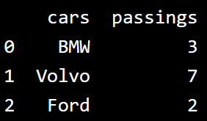
Example
import pandas as pd
mydataset = {
'cars': ["BMW", "Volvo", "Ford"],
'passings': [3, 7, 2]
}
myvar = pd.DataFrame(mydataset)
print(myvar)

Slide 7


Pandas
Pandas as pd
Pandas is usually imported under the pd alias.
alias: In Python alias are an alternate name for referring to the same thing.
import pandas as pd
Checking Pandas Version
The version string is stored under __version__ attribute.

Slide 8
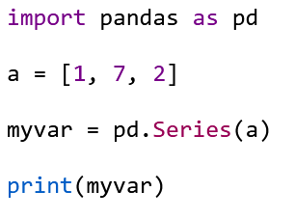
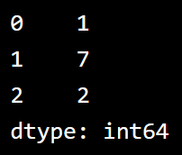
Pandas Series
A Pandas Series is like a column in a table.
It is a one-dimensional array holding data of any type.

Slide 9
Series
Labels
If nothing else is specified, the values are labeled with their index number. First value has index 0, second value has index 1 etc.
This label can be used to access a specified value.
Return the first value of the Series:
print(myvar[0])

Slide 10
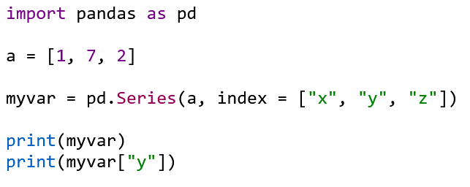
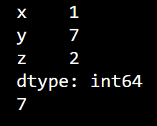
Series
Create Labels
With the index argument, you can name your own labels.

Slide 11
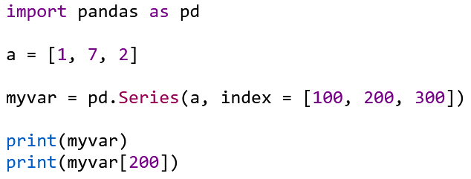
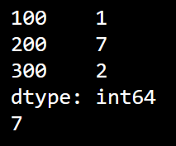
Series

Slide 12
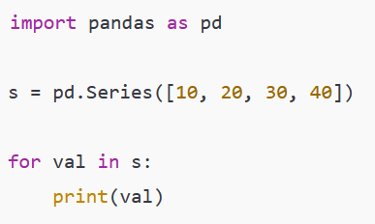

Iterating through a Pandas Series
Iterate over values only

Slide 13


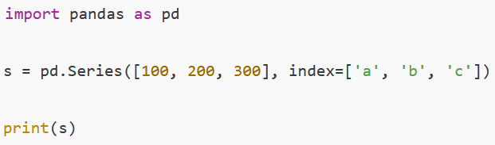
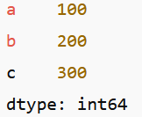
Iterate over index and value

Slide 14




iterate over index + value
Iterate over only the labels (index)
Iterate over only the values

Slide 15


Series
Avoid assuming numeric positions
If index is character-based:
Because Pandas treats 0 as a label, not position.
#KeyError or wrong result

Slide 16
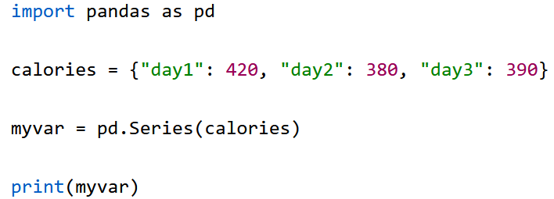
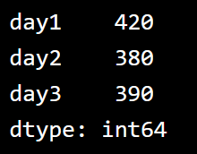
Key/Value Objects as Series
You can also use a key/value object, like a dictionary, when creating a Series.
Create a simple Pandas Series from a dictionary:

Slide 17
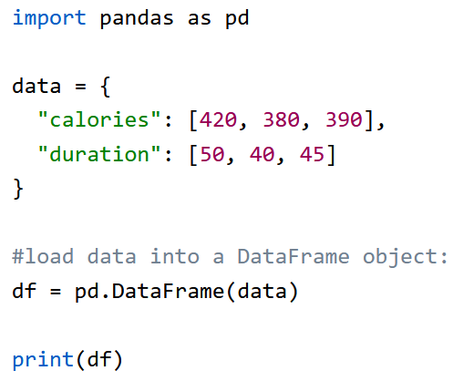
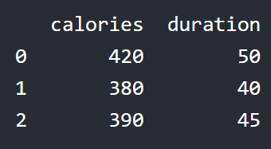
Pandas DataFrames
A Pandas DataFrame is a 2-dimensional data structure, like a 2-dimensional array, or a table with rows and columns.

Slide 18
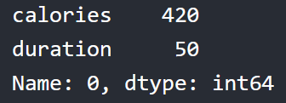


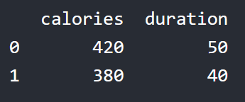
Locate Row
As DataFrame is like a table with rows and columns, pandas use the loc attribute to return one or more specified row(s)

Slide 19
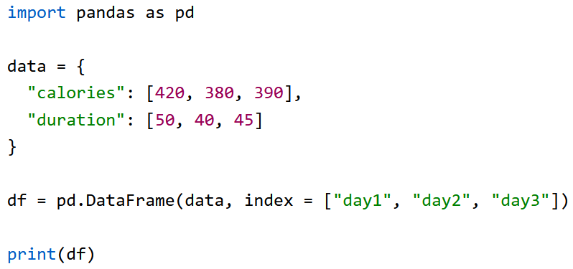
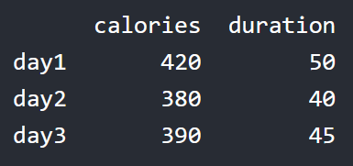
Named Indexes
With the index argument, you can name your own indexes.
Add a list of names to give each row a name:

Slide 20
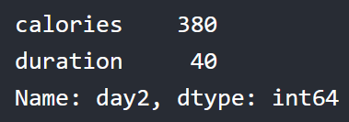

Locate Named Indexes
Use the named index in the loc attribute to return the specified row(s).

Slide 21
Different ways of creating dataframes
From a dictionary of lists (most common)
From a list of lists
From a list of dictionaries
From a dictionary of Series
Create an empty DataFrame
Create DataFrame using zip()

Slide 22
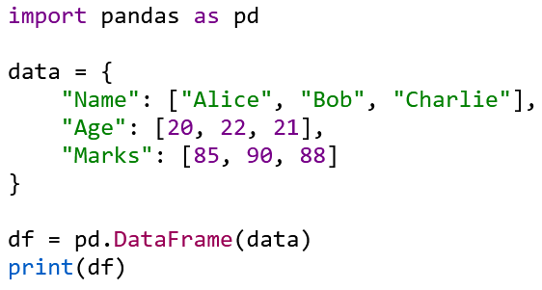
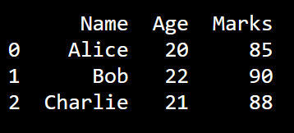
From a dictionary of lists (most common)

Slide 23
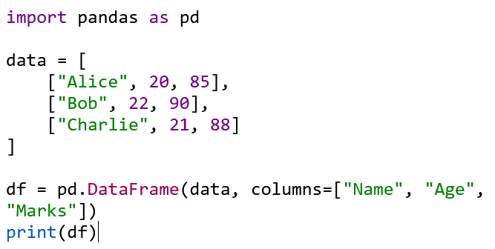
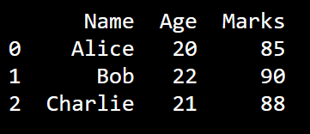
From a list of lists

Slide 24
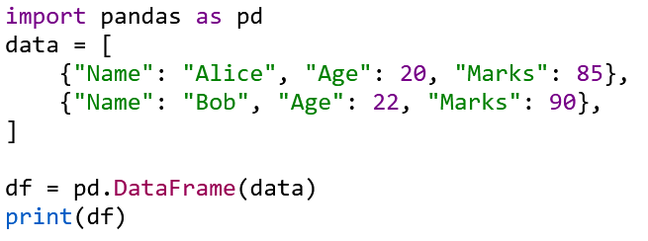
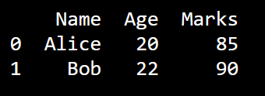
From a list of dictionaries

Slide 25
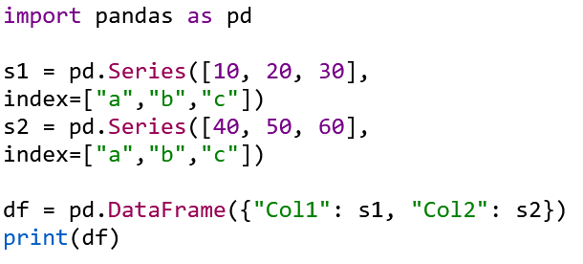
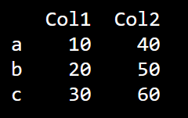
From a dictionary of Series

Slide 26
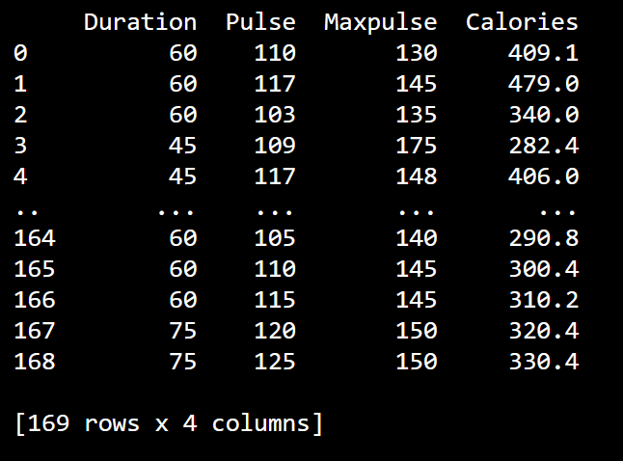
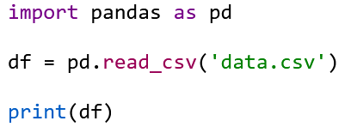
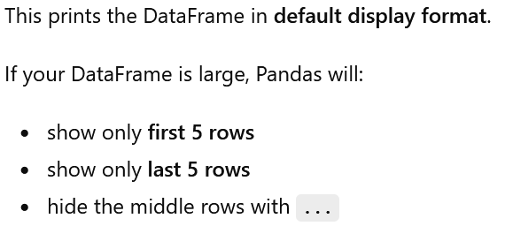
Pandas Read CSV
truncated display.

Slide 27
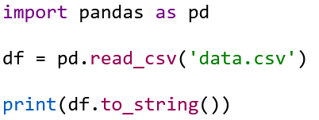
Pandas Read CSV
This prints the entire DataFrame, row by row, without truncation.
to_string() converts the whole DataFrame into one long formatted string.

Slide 28
When NOT to use to_string()
If your DataFrame has:
thousands of rows
or many columns
to_string() will flood your console and make it slow/unreadable.
Best practice

Slide 29
Example
import pandas as pd
df = pd.read_csv('data.csv')
print(df)
print(type(df))
print(df.shape)
print(df.head())
print(df.tail())
print(df.describe())

Slide 30
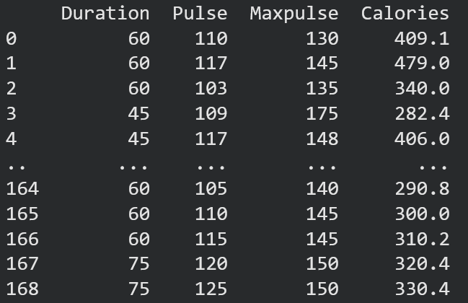
print(df)

Slide 31

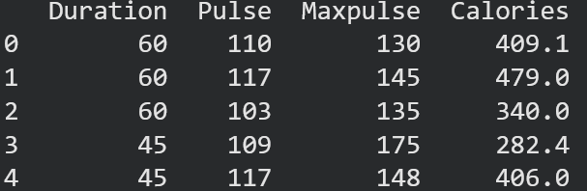
print(type(df))
print(df.shape)
print(df.head())

Slide 32
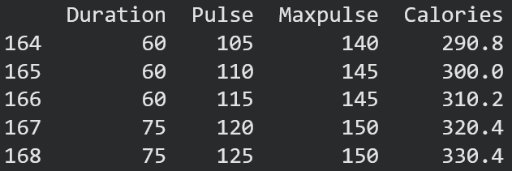
print(df.tail())

Slide 33
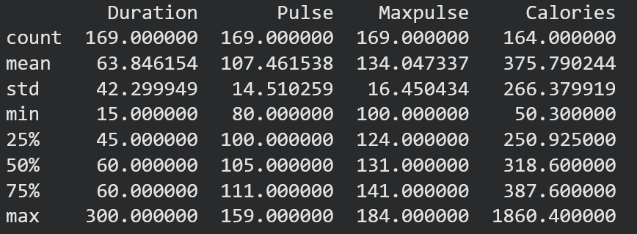
print(df.describe())

